Slide 1




CLOUDLET
Web Developer
Building Digital Experiences for the Modern Web
Presented by
Matthew Collins

Slide 2


CLOUDLET
Introduction
The Foundation of the Modern Internet
Web development refers to the process of designing, building, and maintaining websites and web applications that run on the internet or intranet.
It involves a combination of programming, design principles, performance optimization, and user experience considerations to ensure that digital products are reliable, scalable, and easy to use.

Slide 3

Role of a
Web Developer
CLOUDLET
Developing structured, maintainable, and efficient code that supports long-term scalability and collaboration.
Implementing Designs, Writing Clean Code
Identifying and resolving technical issues related to functionality, compatibility, and performance.
Converting visual layouts into responsive, interactive web pages using code while maintaining design consistency.

Slide 4

Types of Web Developers
Manages server-side logic, databases, and application architecture to ensure data processing and system reliability.
Front-End Developer, Full-Stack Developer
Combines front-end and back-end skills, allowing them to work across the entire web development process.
Focuses on the visual and interactive parts of a website that users directly engage with, ensuring usability and responsiveness.
CLOUDLET

Slide 5
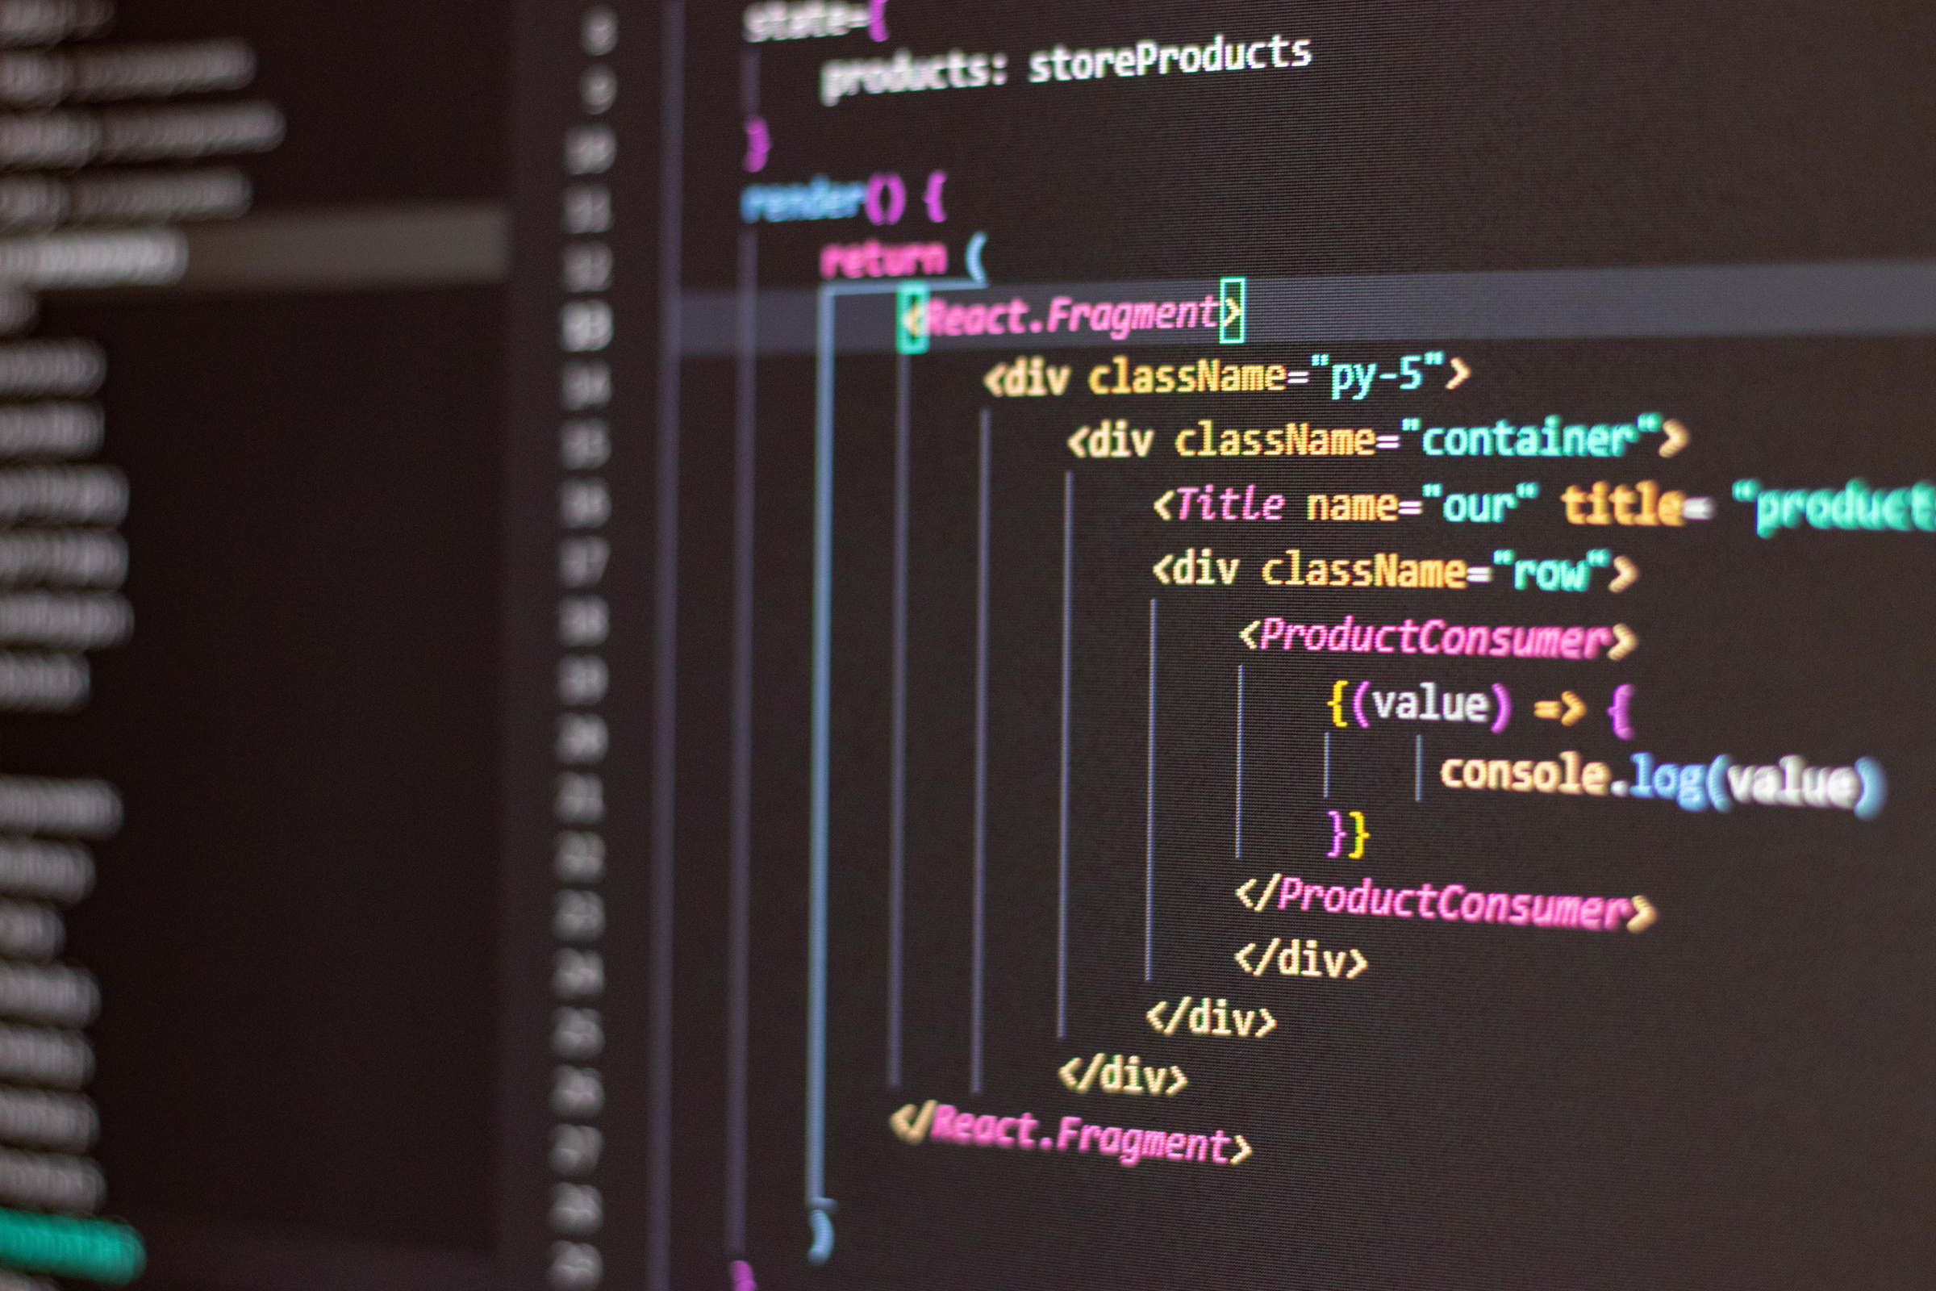
Crafting the User Interface
  User Interface Design
  Responsive Design
  User Interaction
Front-end development focuses on how a website looks and feels to the user. It bridges design and technology, ensuring that visual elements function smoothly across devices and browsers.
Front-End Development
CLOUDLET

Slide 6

CLOUDLET
  Server Logic
  Database Management
  System Integration
Powering the Website Behind the Scenes
Managing how requests are processed and responses are delivered to users.
Storing, organizing, and retrieving data efficiently while maintaining accuracy and security.
Back-End Development
Connecting third-party services, APIs, and tools to extend website functionality.

Slide 7


CLOUDLET
Full-Stack Development
Broader Perspective, Efficiency
Reducing dependency between teams by handling multiple development tasks independently.
Understanding how different components interact within a web application.

Slide 8


Powering the Website Behind the Scenes
Managing how requests are processed and responses are delivered to users.
Frameworks and Libraries
Storing, organizing, and retrieving data efficiently while maintaining accuracy and security.
Connecting third-party services, APIs, and tools to extend website functionality.
CLOUDLET

Slide 9

Development Workflow
Defining goals, requirements, and technical scope before development begins.
CLOUDLET
Development, Testing and Deployment
Writing code, integrating features, and building functionality.
Ensuring reliability, fixing issues, and launching the website to users.

Slide 10





Take the Next Step
Start Building, Learning, and Growing Today
User experience considerations to ensure that digital products are reliable, scalable, and easy to use.
+123-456-7890
www.reallygreatsite.com
123 Anywhere St., Any City
CLOUDLET

